Slide 1
Introduction to Agent-Based Model
CBS 810
Shi Chen and Cristina Lanzas

Slide 2
From Population to Individual
Population-level Model:
Group different individuals in a population
Metapopulation Model:
Separate different populations
Individual (Agent) Based Model:
Treat each individual separately

Slide 3
It’s All about Heterogeneity
Heterogeneity: un-uniform, un-constant, non-linear
Heterogeneous individual host susceptibility/infectivity (supershedder)
Heterogeneous pathogen virulence (superbug)
Heterogeneous environment (hotspot)
…

Slide 4
ABM: A Modeling Framework
Interaction among “individuals” or “agents”
Agent: interacting autonomous entities
-- can carry multiple properties (state variables)
-- pre-defined “behavior” and activity
-- outcome depends on all agents

Slide 5
Protocol of ABM
1. Purpose:
What is the purpose of the model?
Why we need to use ABM instead of population-level models?
- Advantages?
- Disadvantages?
Grimm et al. 2010 Ecological Modelling

Slide 6
Protocol of ABM
2.1 Entity (Agents):
What kind of entities? What temporal-spatial resolution? What state variable/attributes do they carry?
2.2 State Variables:
What differentiate an agent from the other ones (e.g., sex, age, epidemiological status)?
Notes:
Entity: agents/spatial units (e.g. grids)/environments/collective population subpopulations

Slide 7
Protocol of ABM
3. Process:
Who does What?
When does interaction/event occur, and in what order?
Is time discrete or continuous?

Slide 8
Protocol of ABM
4. Design Concepts
4.1 Basic Principles
Which general concepts/hypothesis underlies the model?
4.2 Interaction
What kind of interactions are assumed among agents, and how?
4.3 Stochasticity
Does the model incorporate stochasticity? What kind of stochasticity?

Slide 9
Protocol of ABM
5. Input Data and Initialization
What external data sources are used?
Initial values of variables
Parameter values

Slide 10
Protocol of ABM
6. Sub-model (module)
What sub-models are in the model?
How the processes are related to the sub-models?

Slide 11
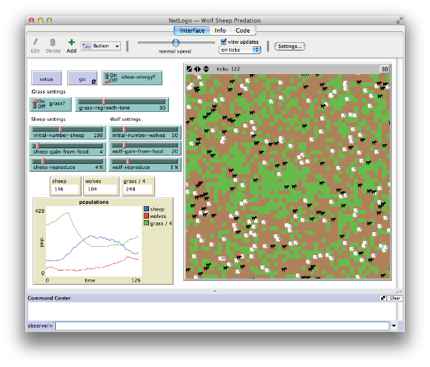
NetLogo: ABM Simulator
A “Hybrid” ABM Simulator
User-interface
Embedded code
Real-time simulation
Notes:
http://www.netlogoweb.org/launch#http://www.netlogoweb.org/assets/modelslib/Sample%20Models/Networks/Virus%20on%20a%20Network.nlogo

